Slide 1
APUSH Review: Key Concept 6.2, revised edition
Everything You need to know about key concept 6.1 to succeed in apush

Slide 2
Key Concept 6.2
“The migrations that accompanied industrialization transformed both urban and rural areas of the United States and caused dramatic social and cultural challenges.”
Page 63
Big Idea Questions:
Why were individuals attracted to cities? What opportunities were there in cities?
How did the federal government encourage westward expansion? What were the impacts of this expansion on Natives?
How did immigrants adapt to life in America?

Slide 3
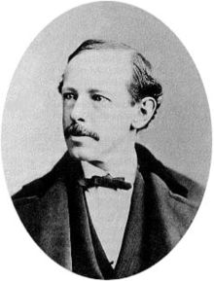
Key Concept 6.2, I
“International and internal migration increased urban populations and fostered (encouraged) the growth of a new urban culture”
Page 63
A) Cities saw tremendous economic growth - factories and businesses
International Migrants
Immigrants from Asia - China - settled on West coast - RR workers
Southern and Eastern Europe - “New” immigrants - Italy, Poland, Russia
10,000,000 between 1860 and 1890
Internal Migrants
African Americans within the South and out of the South - to escape sharecropping
Why were migrants (both internal and international) moving to cities?
Escape poverty
Religious persecution - Jews in Russia fled to the US
Limited opportunities for social mobility - “rags to riches” in US - Horatio Alger stories

Slide 4
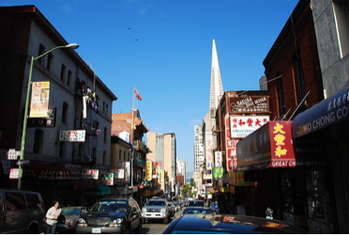
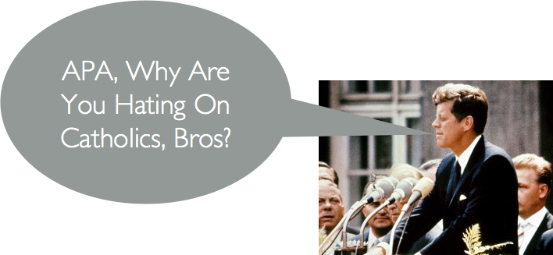
Key Concept 6.2, I
B) Emergence of urban neighborhoods based on:
Ethnicity, race, and class
“Little Italy,” “Chinatown”
Provided new cultural opportunities
C) Debates over assimilation were a result of international migration
Rise of nativism (again)
APA - sought to limit immigrants and keep Catholics from holding office
Similar to Know Nothing Party of 1840s and 1850s
Immigrants often compromised between their own cultures and US culture
2nd generation were more likely to assimilate than 1st generation
Public schools only taught English

Slide 5
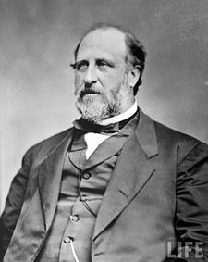
Key Concept 6.2, I
D) Political Machines:
Provided jobs and services for constituents (voters), especially immigrants and poor - Tammany Hall
E) Emergence of a distinctive middle class:
Caused by:
New managerial workers in factories and clerical workers (male and female)
Increased education opportunities
Consumer culture grew during this time
Baseball, Vaudeville shows

Slide 6
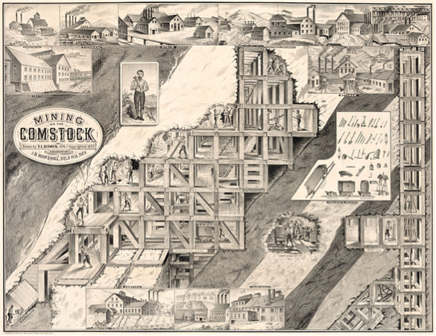
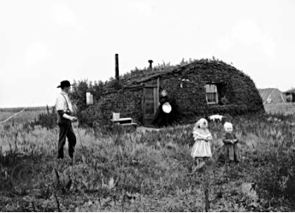
Key Concept 6.2, II
“Larger numbers of migrants moved to the West in search of land and economic opportunity, frequently provoking competition and violent conflict.”
Page 64
A) Reasons for westward growth:
Transcontinental RR - built by Irish and Chinese
Discovery of mineral resources - mines - Comstock Lode
Government policies - Homestead Act, subsidies to RR companies

Slide 7
Key Concept 6.2, II
B) Migrants moved to rural and boomtown areas of the West
Why? - seeking independence and self-sufficiency
“Safety-valve” theory
Opportunities out west?
Building RRs, mining, farming, and ranching
C) Impacts of western migrations?
Decimation of bison (buffalo)
Conflict with Natives and Mexican Americans over land
Sand Creek Massacre (1864) - 133 Natives, mostly women and children were killed

Slide 8
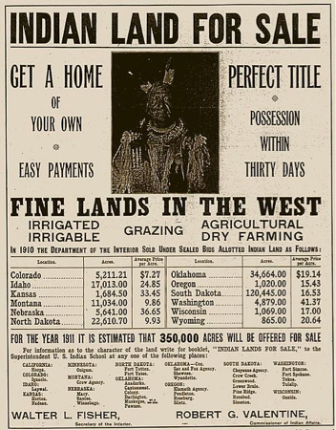
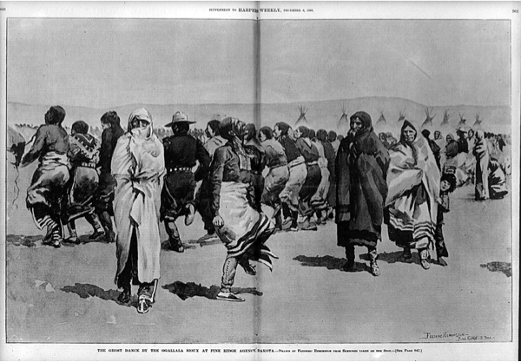
Key Concept 6.2, II
D) US government relations with Natives
Often violated treaties
Used military force
Wounded Knee - 1890 - 300 Natives were killed (women and children)
Natives were moved to reservations
Loss of sovereignty
E) How did Natives preserve their cultures in the face of assimilation policies?
Assimilation Policy - Dawes Act (1887):
Sent Native children to boarding schools, had to speak English
Native families given individual plots of land
Ghost Dance - ceremony in which Natives envisioned the return of buffalo and elimination of whites
Self-sustaining economic practices - farming

Slide 9
Test Tips
Multiple-Choice and Short Answer:
Reasons for westward expansion
Ways immigrants adapted to life in America
Impact of westward expansion on Natives (Dawes Act)
Essays:
Comparing reasons for and effects/experiences of immigration groups
Impact of westward expansion on Native Americans

Slide 10
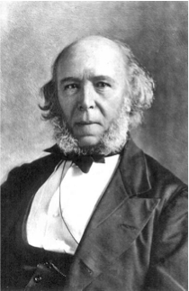
See You Back Here For 6.3!
Thanks for watching
Good luck in May!

